Slide 1

Analyzing Human Resource Dynamics and Predicting Attrition
Insights and Strategies for Effective Workforce Management

Slide 2



Data Source
Although We got a good model , We knew data were not accurate and data were not even.
Attrition variable is imbalance with “Yes” having 237 instances and “No” with 1233 instances.

Slide 3

The version of the importance of understanding human resource dynamics and attrition
Retaining Talent: Understanding attrition helps retain top talent and minimize recruitment and training costs.
Workforce Planning: Analyzing dynamics aids in anticipating future workforce needs and developing recruitment and succession strategies.
Employee Engagement: Insights into workforce dynamics improve engagement and satisfaction, leading to better performance.
Talent Acquisition: Understanding desired qualities in the job market informs recruitment strategies.
Performance Management: Analysis helps identify areas for improvement and tailor development initiatives.
Organizational Effectiveness: Insights into dynamics drive a positive work environment and enhance overall

Slide 4

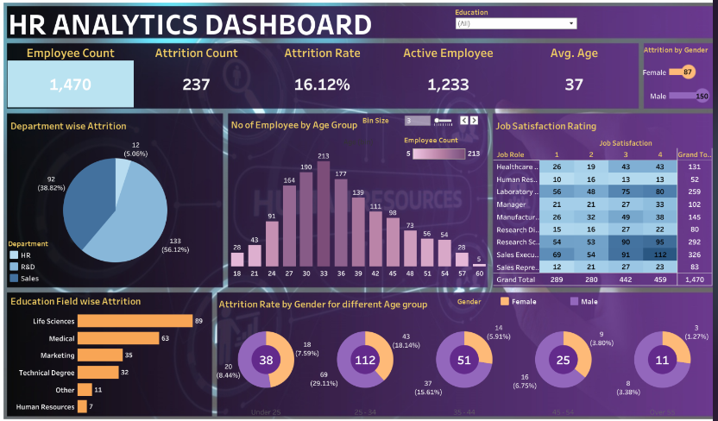

Slide 5

Importing and Cleaning Data
Pandas
Matplotlib
Sklearn
Tableau
MongoDB
Google Colab
Dropping unnecessary columns using (drop) function
Scaling the numerical data using (StandardScaler)

Slide 6
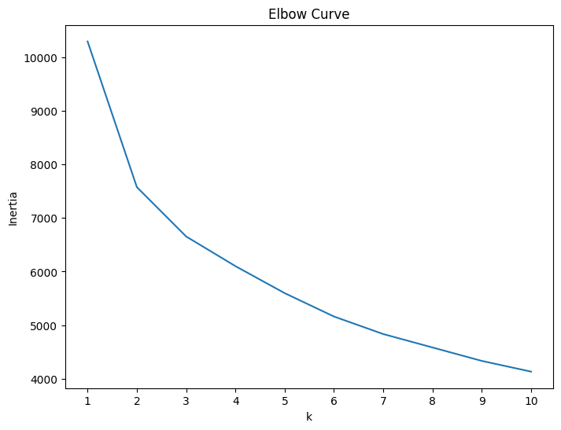
What’s best K-value
Create a list with the number of k-values from 1 to 11.
Create an empty list to store the inertia values.
Create a for loop to compute the inertia with each possible value for K.
To plot the Elbow curve.
Found best K-value is 3.

Slide 7
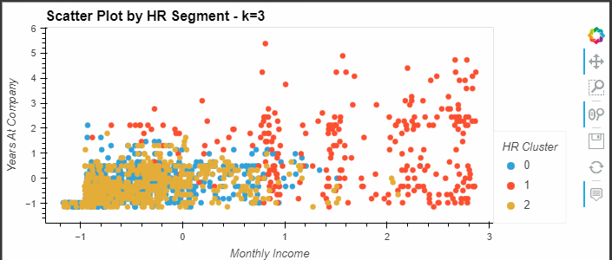
Visualize the Clusters
Initialise the K-Mean model using the best value for K.
Create a scatter plot with x=“Age”, y=“Years At Company”, by=“HR Cluster”, hover_cols = “Department”

Slide 8
Attrition Prediction
Separation of features (X) and the target variable (y)
Encode the categorical variables using get_dummies.
Splitting of the dataset into training and testing sets.
Scaling the data using StandardScaler.
Using the K-nearest Neighbors(KNN) Classification

Slide 9

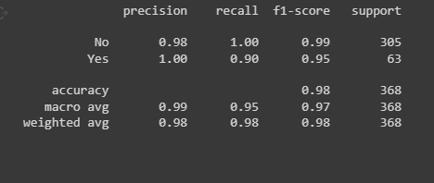
The classification report

Slide 10

Data Storage (ETL)
Using MongoDB store data.
Import data with Mongoimport
Create database is “hrdata”
Create collection is “employee”

Slide 11
Conclusion
Understanding human resource dynamics and attrition is crucial for effective workforce management.
High attrition rates can indicate underlying issue such as job dissatisfaction, poor management, lack of career development opportunities, or inadequate compensation and benefits.
On the other hand, low attrition rates may suggest employee satisfaction and stability within the organization

